Slide 1
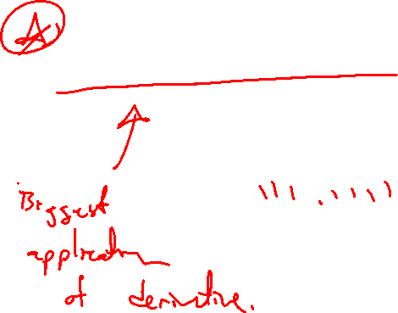
Section 4.7 Optimization Problems
Lecture 1
Min and max applied

Slide 2

Homework Submission to Canvas
Preview of section
Skim the section in text and write a short paragraph summary.
Give a bulleted list of all important definitions, theorems, and formulas without details.
Notes on video lectures
Take notes on everything written on slides including all details, worked examples, on-own activities, as well as your own thoughts and questions.
Try on-own activities first, then write down provided solution next to it for comparison.
Worked examples from the text
Write down the problem and attempt without looking at the solution.
Use the solution to write the best explanation you can.
Solutions to textbook exercises
Model approaches and explanations given in the video lectures and textbook examples.
Final reflection of section
List the key takeaways to remember as a bulleted list.
Video reflection (for some sections)
Write a 1 paragraph reflection on the video discussing what you found most interesting or useful.

Slide 3
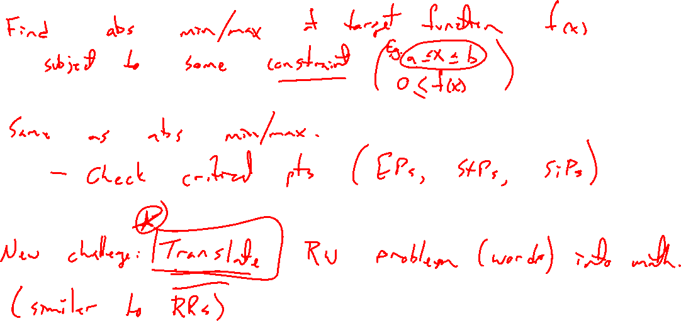
Optimization: Find the biggest or smallest
Notes:
Find min/max of a target function f(x) subject to some sort of constraint ( a \leq x \leq b).
Same as abs min / max problem.
Check critical points (stationary, singular, endpoints)
Difficulty is translating the problem into math (function)

Slide 4

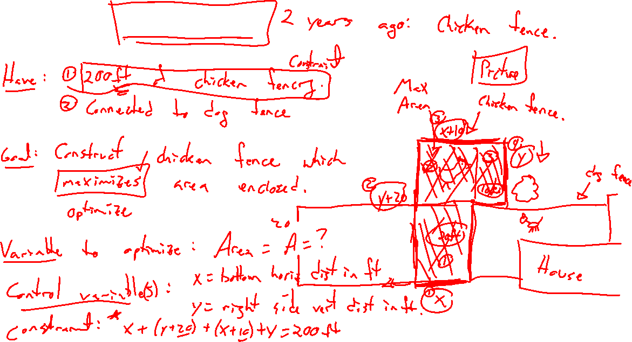
Example: Try on own
Notes:
Chicken fence
Think of general steps just as with related rates

Slide 5

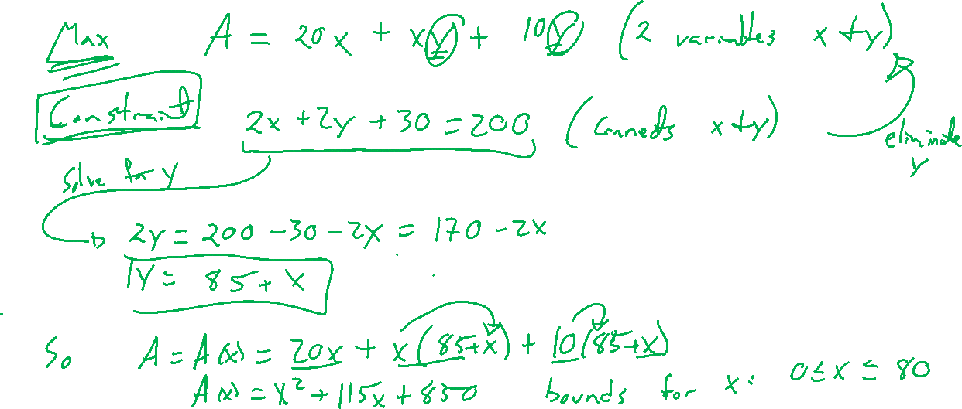
Example: Try on own
Notes:
Chicken fence
Think of general steps just as with related rates

Slide 6
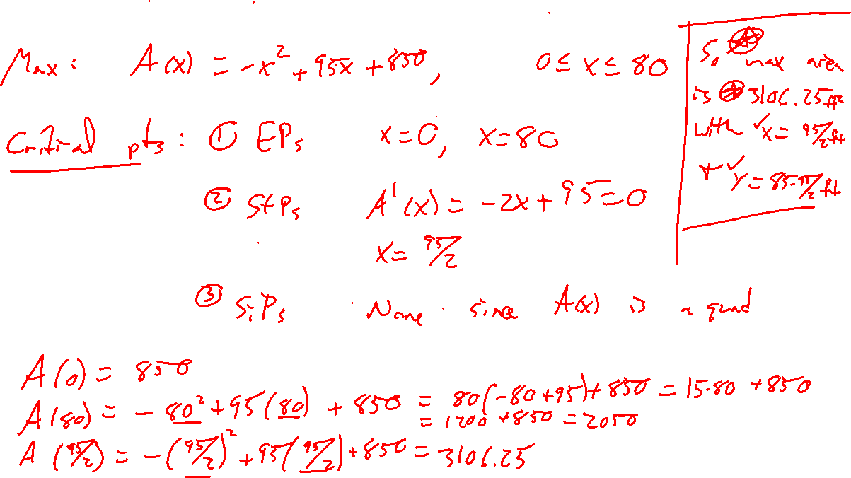

Slide 7
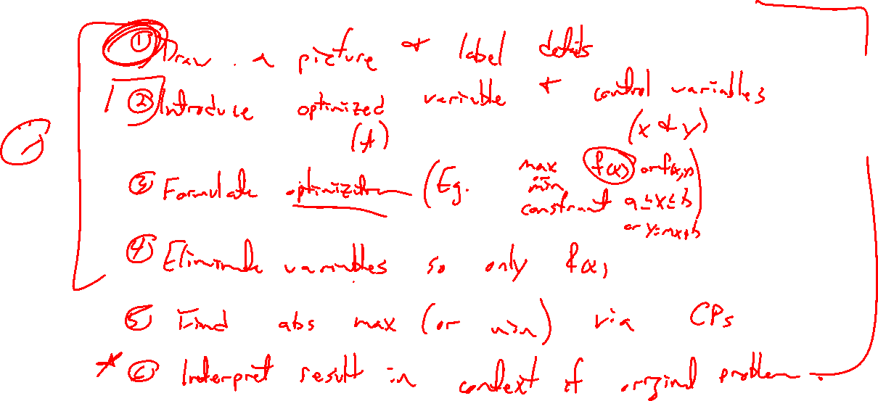
Steps for optimization problems
Notes:
Similar to related rates

Slide 8
Example: Try on own
Notes:
Oil can optimization. 1 liter in volume. Minimize materials used.
What if cost of lids were twice that of sides?

Slide 9
Example: Try on own
Notes:
Oil can optimization. 1 liter in volume. Minimize materials used.
What if cost of lids were twice that of sides?

Slide 10

Computing and mathematical optimization
Notes:
Wiki page
UWL journal ug research paper

Slide 11
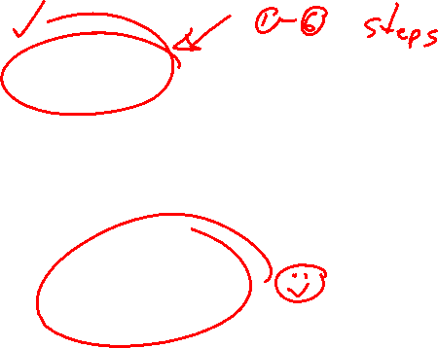
Textbook Examples and Exercises
Rework examples 1, 3, 4, 6 in the text. Steps:
Write down a problem.
Close the book and attempt on own.
Check / correct your solution against the text solution.
If needed, rewrite the problem to be of the quality of the text solution.
Complete exercises 15, 21, 37, 41
Write solutions of the same quality as in lecture and text solutions.
Check your solution against the answer in the back of the book.
Video reflection
NONE

Slide 12

Homework Submission to Canvas
Preview of section
Skim the section in text and write a short paragraph summary.
Give a bulleted list of all important definitions, theorems, and formulas without details.
Notes on video lectures
Take notes on everything written on slides including all details, worked examples, on-own activities, as well as your own thoughts and questions.
Try on-own activities first, then write down provided solution next to it for comparison.
Worked examples from the text
Write down the problem and attempt without looking at the solution.
Use the solution to write the best explanation you can.
Solutions to textbook exercises
Model approaches and explanations given in the video lectures and textbook examples.
Final reflection of section
List the key takeaways to remember as a bulleted list.
Video reflection (for some sections)
Write a 1 paragraph reflection on the video discussing what you found most interesting or useful.

